Slide 1
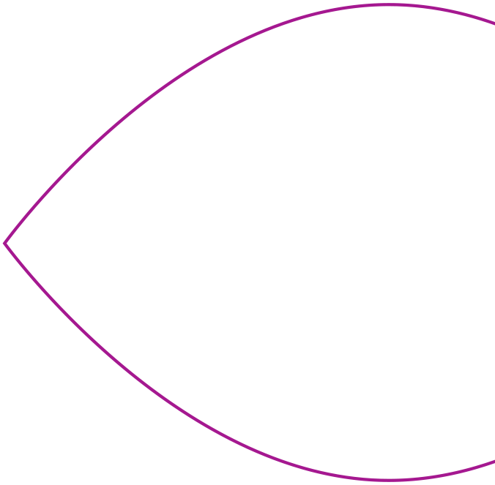
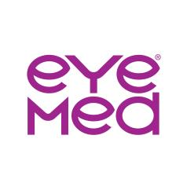
WELCOME TO EYEMED
Vision benefits
for every set
of eyes
USA Today
11/5/2026

Slide 2
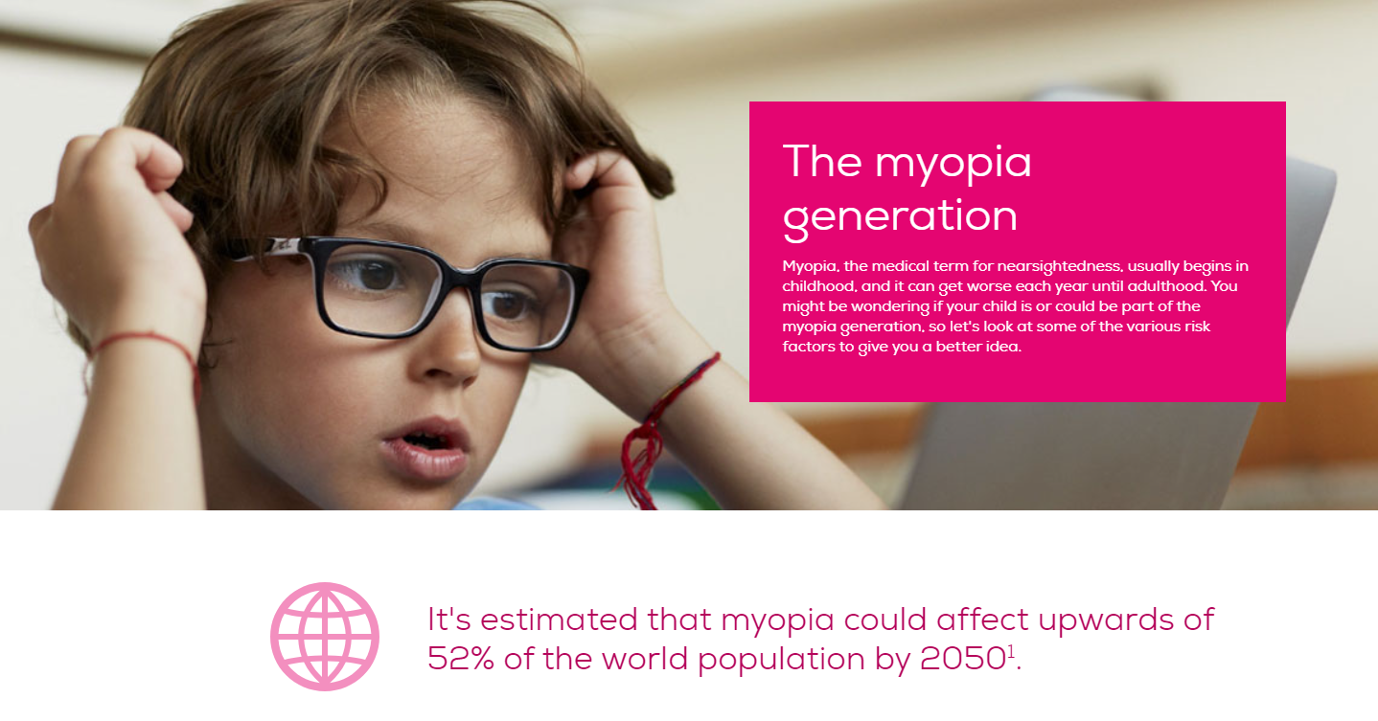
Even without a prescription, eye exams can help you see and feel your best.
An eye exam can spot early signs of diabetes, high blood pressure, high cholesterol and heart disease.¹ Not to mention cataracts and glaucoma.
The average American spends over 7 hours looking at a screen each day.² All this exposure can put strain on our eyes and may be linked to blurred vision, dry eye and headaches.
Your eyes are always changing. Our network doctors can track even the slightest changes with the latest in digital exam technology and retinal imaging.
UV rays can cause cataracts, macular degeneration, vision loss and eye sunburn. Even in winter. Sunglasses can easily block 99% of these rays.³
Check out our full library of
vision health and wellness articles,
videos and interactives at eyesiteonwellness.com.
¹Mukamal, R.; “20 Surprising Health Problems an Eye Exam Can Catch”; American Academy of Ophthalmology; aao.org; April 29, 2022. ²Moody, R.; “Screen Time Statistics: Average Screen Time in US vs. the rest of the world”; Comparitech; comparitech.com; March 21, 2022. ³“Recommended Types of Sunglasses,” American Academy of Ophthalmology; aao.org; March 20, 2023.

Slide 3

With an EyeMed membership, you have the freedom to get exactly what you want.
Access to thousands of in-network providers—independent eye doctors, your favorite retail stores, even online options. And, when you stay in-network, your eye doctor will submit your vision claim for you.
Freedom to choose any frame and nearly any lens or contact lens. Plus, use our exclusive offers and discounts* on top of your benefits to save extra on things like frames, lenses, eyewear accessories, Lasik, and more.
Create an account on our Member Web to view eligibility and coverage, use our cost estimator, view available special offers, and search for in-network providers. Enroll in our e-newsletter for the latest in vision.
Stay mobile with the EyeMed App and text alerts.
¹Based on weighted average of sample transactions: EyeMed Insight network/$10 exam copay/$10 materials copay/$150 frame or contact lens allowance. 2021 EyeMed Commercial BOB stats. *At participating in-network providers

Slide 4



You’re on EyeMed’s Select network,
so you’ve got choices — lots of them
More than 174,000 provider access points at 38,000 locations, including:
And your local providers:
MyEyeDr, Innovative Eye Care, & Piedmont Eyecare
Plus, online options:

Slide 5
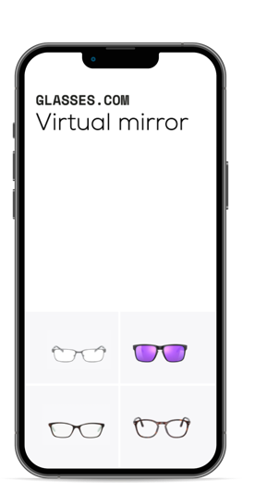



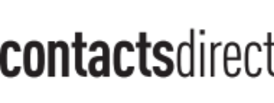
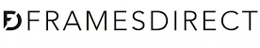


ONLINE IN-NETWORK
Our online providers offer the
brands members want most
One of the largest online collections —
15,000+ frame styles¹
Insurance benefits applied in cart — no paperwork or claims
Virtual try-on and Frame Advisor tools
Easy prescription verification — just snap a pic
and send
Shop online with in-store adjustments
Free shipping and return
Part of our PLUS Provider network²
New!
¹Compared to EyeMed’s closest competitors based on membership count, 2024. ²Member access to PLUS Providers is only available in conjunction with the Eye360 product and is not available in all states. Eye360 benefits not available in the State of Texas. Insured benefits cannot be used on Oakley® custom sunglasses, ski goggles or accessories, footwear and apparel. Fully insured clients are underwritten by: Fidelity Security Life Insurance Company®, Kansas City, MO 64111 and Fidelity Security Life Insurance Company® of New York.
New!
5

Slide 6
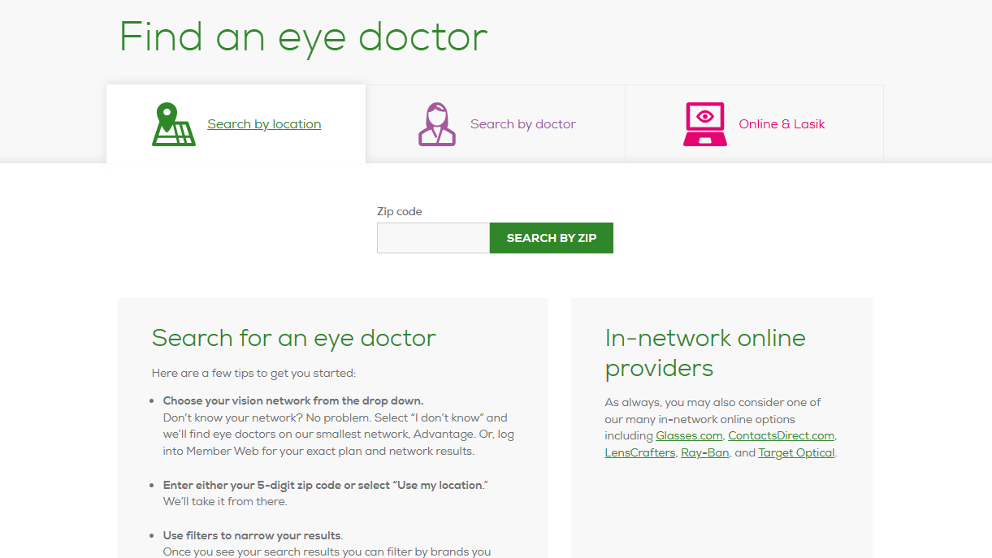
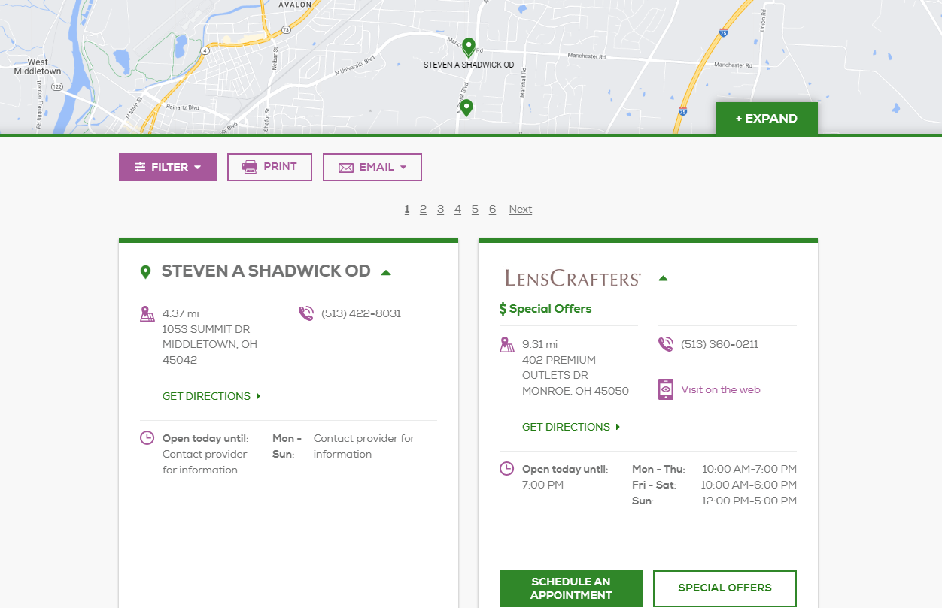
EyeMed’s Provider Locator
Helping you find the eye care and services that best meet your needs
  Search for your eye doctor by name or enter your zip code for a complete listing of in-network providers closest to you.
  Use the map and driving directions to help you get to your selected location.
  Narrow down your search by using the 8 different filter options available and view specific information about providers such as their specialties and brands available at their location.
  Many of our providers offer online appointment scheduling through the provider locator.
  Quickly identify where Special Offers are available.
  Visit the “Online & Lasik” tab to link directly to our online in-network provider options or to find Lasik providers near you.

Slide 7
USA Today Plan Options
In-Network Schedule | Low Plan |  | High Plan
Exam copay Exam Standard Contact Lens Fit/Follow | $10 $39 charge |  | $10 $39 charge
Retinal Imaging | Up to $39 |  | Up to $39
Frame | $130 allowance, 20% off balance over $130 |  | $170 allowance, 20% off balance over $170
Lens co-pay (single vision, bifocals, trifocals) | $10 co-pay |  | $10 co-pay
Standard Progressives | $60 co-pay |  | $10 co-pay
Premium Progressives | Tier 1-4: $95,$105,$120,$185 |  | Tier 1-4: $95,$105,$120,$185
Lens Options UV Tint- solid or gradient Standard Scratch Polycarbonate (Adults) Polycarbonate (Kids <19) Standard Anti-Reflective | $15 $15 $15 $40 $0 $45 |  | $15 $15 $15 $0 $0 $0
Contact Lens | $0 copay, $130 allowance |  | $0 copay, $170 allowance
Frequency | Exam- Lenses or Contacts- Frame- | Once every plan year Once every plan year Once every other plan year | Exam- Lenses or Contacts- Frame- | Once every plan year Once every plan year Once every plan year

Slide 8
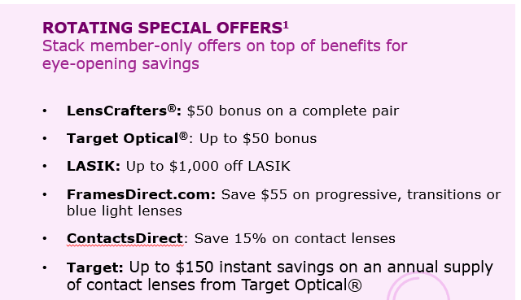
Enjoy more extras with member-only savings & discounts
40% off additional pair of glasses
15% off standard LASIK prices or 5% off the promotional price
20% off any remaining balance over the frame allowance
Up to 64% off the retail price on thousands of hearing aids from the top brands with Amplifon
15% off any balance over the conventional contact lens allowance
20% off any non-covered items, including non-prescription sunglasses
Current 2026 Special Offers /
2027 Special offers coming soon
Login to your account on EyeMed’s Member Web and visit the “Special Offers” tab to see the full list of available offers.
Discounts are not insurance. At participating in-network providers. Some exclusions may apply. Log into Member Web for details.

Slide 9

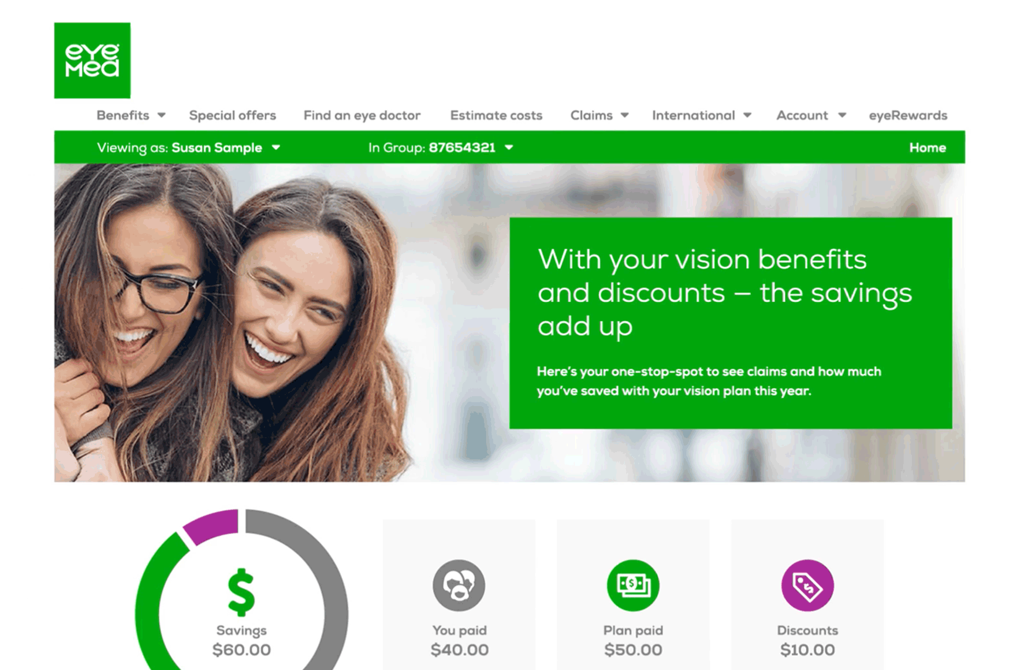
MEMBER WEB
Our one-stop-shop for all things vision
We make it easy for members to feel in control and manage everything about their vision benefits.
MEMBERS CAN—
View Savings Dashboard
Browse benefits and claims
Grab special offers¹
Find an eye doctor
Estimate out-of-pocket costs (if any)
Discover helpful vision guides and resources
NEW in 2025:
Expanded Language Options: English, Spanish, French & Chinese
Demo video
¹Special offers are not insured benefits. Offers not valid in the State of Texas.
9

Slide 10
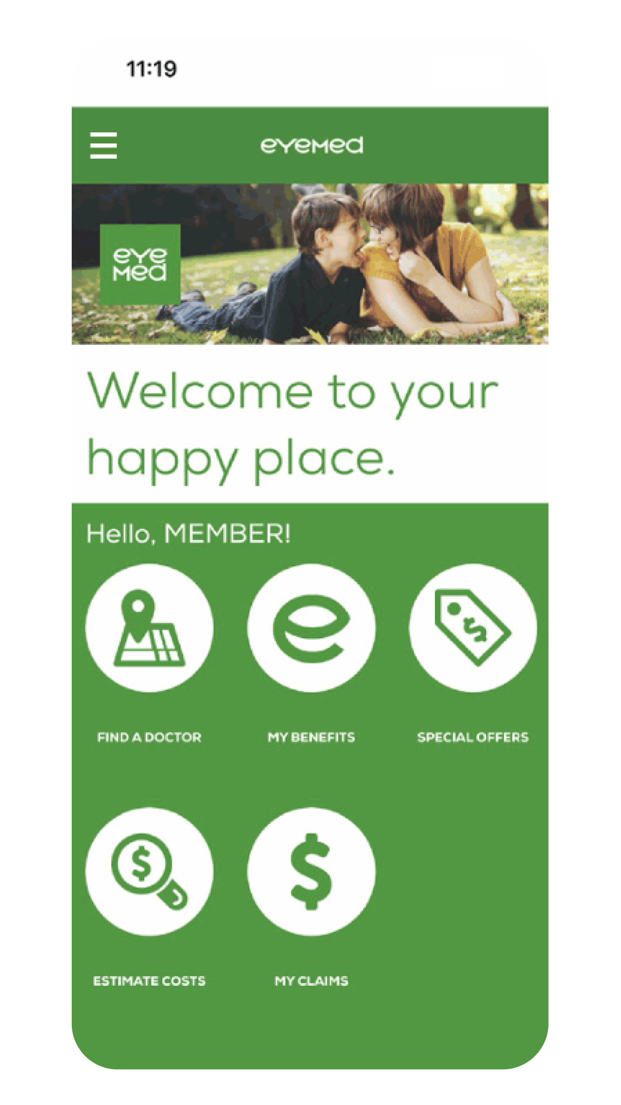
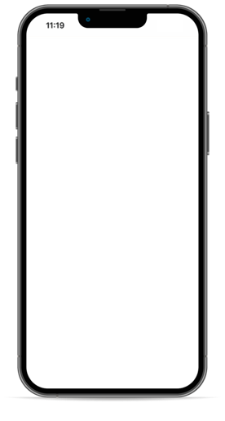
MEMBER APP
Vision benefits: wherever, whenever
With the highest rating in the industry, our EyeMed app is a member favorite.
4.8
¹
Find an eye doctor
View your benefits
Save ID card & special offers² to Apple wallet
Set appointment reminders
Upload and save your prescription
Check the status of your vision claim
Added Features in 2025
“Favorite” providers for easy ID card access when in their area
Ride share connectivity
“Love this app!”
“Easy and
convenient”
“Really great!”
Demo video
¹Based on 22k ratings on the App Store, December 2025. ²Special offers are not insured benefits. Offers not valid in the State of Texas.
10

Slide 11
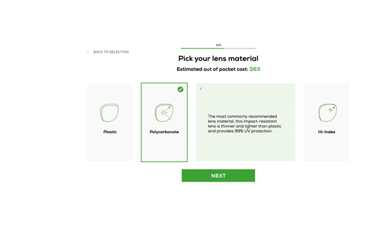
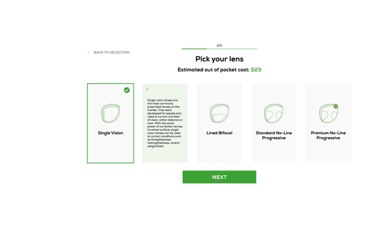
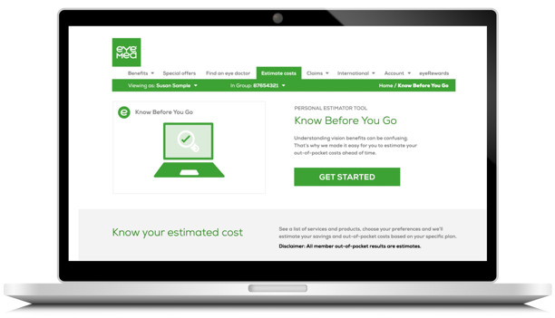
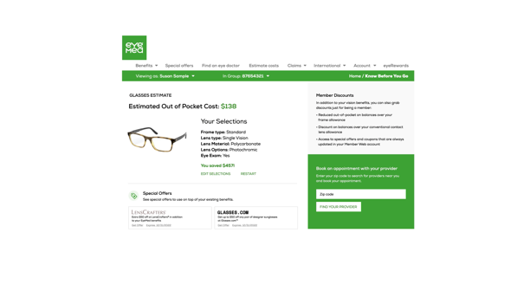
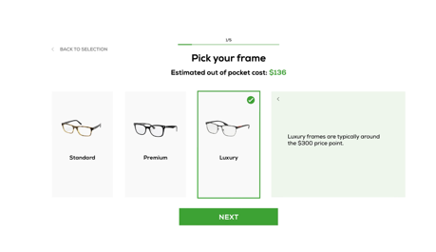
KNOW BEFORE YOU GO¹
A smart tool for smart shoppers
Surprise out-of-pocket costs can make members feel lost. But our cost estimator helps members anticipate what they might pay before shopping.
INCLUDE LINK TO KBYG DEMO VIDEO
  Members choose anticipated services and products
  Easy-to-understand explanations of different
  types of frames, lenses, add-ons and contacts
  Members can see their plan-specific estimated out-of-pocket cost total (if any)
1 Excludes the following plans: reseller, exam-only, safety & VDT, global allowance and declining balance.
2 Cass, A.; “44% skipped healthcare over cost uncertainty, survey says”; Becker’s Hospital Review;.beckershospitalreview.com; May 2022.
KBYG Demo Video

Slide 12

Award-winning Customer Care Center
Providing live support for all your EyeMed questions
14 years as one of America’s highest-rated call centers by Benchmark Portal¹
9 seconds or less wait time²
99% first-call resolution³
362 days of availability per year:
  866-723-0514
  Visit the EyeMed: eyemed.com/en-us/
  Monday - Friday: 8 am – 11 pm EST
  Saturday: 8 am – 11 pm EST
  Sunday: 11 am – 8 pm EST
  Closed Easter, Thanksgiving and Christmas
¹Purdue University Benchmark Portal independent assessment of call centers nationwide, 2023. ²EyeMed Customer Care Center Reporting, 2023. ³EyeMed incoming call analysis, 2023.

Slide 13

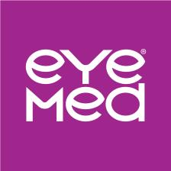

Enroll today
There’s more to love with EyeMed
Learn more at eyemed.com/enroll
Follow us:
PPT-2308-M-669

